Slide 1
Principles of Data Communication [L T P C] is [3 1 0 4]
ICT 2156

Slide 2
Course Outcomes
Apply the concepts of data communication systems to calculate channel capacity.
Analyse different encoding and modulation schemes
Compute frame check sequence and error correction codes.
Analyse flow and error control protocols
Compute the performance of media access protocols

Slide 3
ICT 2156: PRINCIPLES OF DATA COMMUNICATION [3 1 0 4]
Objectives:
To understand basics of data communication
To understand error detection and correction techniques
To understand data link layer protocols
To understand the performance of media access protocols
Abstract:
Introduction to Data Communication, Signals, Basic properties of data communication system, Nyquist rate, Shannon Capacity, Signal encoding and Tx and Rx models, Modulation schemes. Properties of Media and digital transmission systems, wired and wireless medium, Error detection and correction, Block codes, CRC, Hamming code, Stop and wait flow control, Sliding window flow control, ARQs, HDLC, Multiplexing, Media Access Sublayer and LAN, Approaches to sharing transmission medium, Random access protocols, Token passing protocols, IEEE LAN standards, Bridges, MAN, FDDI.

Slide 4
Syllabus:
Data Communication fundamentals: Introduction to Data Communication, Signals, Digital representation of information, Basic properties of data communication system, Time and frequency domain characterization of communication channels, Nyquist signaling rate, Shannon Channel capacity, Line coding-NRZ, bipolar, Manchester, Differential Manchester encoding, Modems and digital modulation- ASK, FSK, PSK, QAM. [14 hours]
Properties of Media and Digital Transmission Systems: Twisted pair, Coaxial cable, Optical fiber, Wireless transmission. [04 hours]
Error detection and correction: Asynchronous and synchronous transmission, Error detection and correction basics, Parity check, Internet checksum, Polynomial codes, Block codes, Hamming code. [08 hours]
Peer to Peer Protocols: Peer to peer protocols and service models, ARQ protocols- Stop and wait, Go back N, selective repeat, Transmission efficiency of ARQ protocols, Other adaptation functions- Sliding window flow control, Timing recovery for synchronous services, Reliable stream service, Data link control- HDLC datalink control, point to point control. Multiplexing-FDM, TDM, STDM. [14 hours]

Slide 5
Media Access sublayer and LAN: Introduction to layered architecture, Protocols, Approaches to sharing transmission Medium, Random Access Protocols, Token Passing protocols, IEEE LAN standards, Bridges, MAN[IEEE802.6], FDDI. [08 hours]
Course Outcome
The students will be able to
Apply the concepts of data communication system to calculate channel capacity.
Analyse different encoding and modultaion schemes.
Compute frame check sequence and error correction codes.
Analyse flow and error control protocols
Compute the performance of media access protocols
References:
1. Stallings W., Data & Computer Communications (9e), Pearson Education Inc., Noida, 2017.
Frozen B., Introduction to data communication & networking (4e), Tata McGraw Hill, New Delhi-2014.
Garcia A. L., Widjaja I., Communication Networks (2e), Tata McGraw Hill, 2011.

Slide 6
What is Data communication?
It is the physical transfer of data over a point to point or point to multipoint communication channel.
Data communications deals with the transmission of signals in a reliable and efficient manner
Networking deals with the technology and architecture of the communications networks used to interconnect communicating devices.

Slide 7
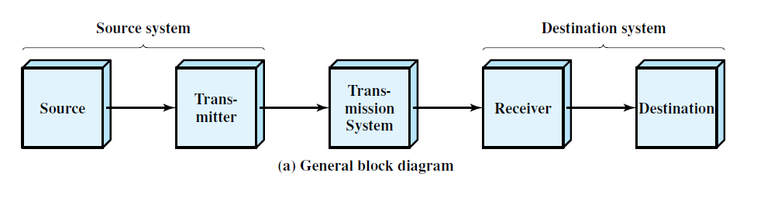
1.2 A COMMUNICATIONS MODEL
a simple model of communications

Slide 8
The key elements of the communications model are as follows:
• Source: This device generates the data to be transmitted; examples are telephones and personal computers.
Transmitter:
the data generated not transmitted directly
a transmitter transforms and encodes the information in such a way as to produce electromagnetic signals that can be transmitted
Transmission system: This can be a single transmission line or a complex network connecting source and destination.

Slide 9
Receiver: The receiver accepts the signal from the transmission system and converts it into a form that can be handled by the destination device.
• Destination: Takes the incoming data from the receiver.

Slide 10
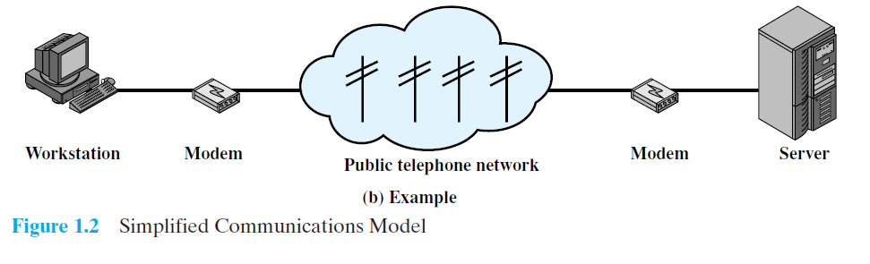
Figure 1.2b presents one particular example, which is communication between a workstation and a server over a public telephone network.
Another example is the exchange of voice signals between two telephones over the same network.

Slide 11
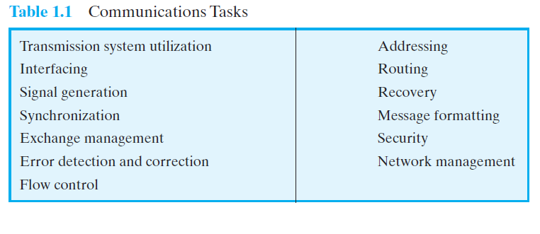
Table 1.1 lists some of the key tasks that must be performed in a data communications system. The list is somewhat arbitrary: Elements could be added; items on the list could be merged;
Fig reference

Slide 12
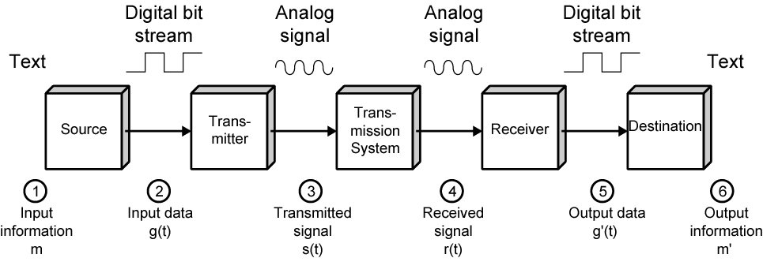
Data Communications Model

Slide 13
Conversion Techniques
Data | Signal | Approach
Digital | Digital | Encoding
Analog | Digital | Encoding
Analog | Analog | Modulation
Digital | Analog | Modulation

Slide 14
Transmission Medium
Guided(Wired)
Unguided
(Wireless)
Twisted Pair Cable
Coaxial Cable
Fiber Optic Cable
Air

Slide 15
Book Referred in this PPT
Stallings W., Data & Computer Communications (9e), Pearson Education Inc., Noida, 2017. Chapter 1.

